Slide 1
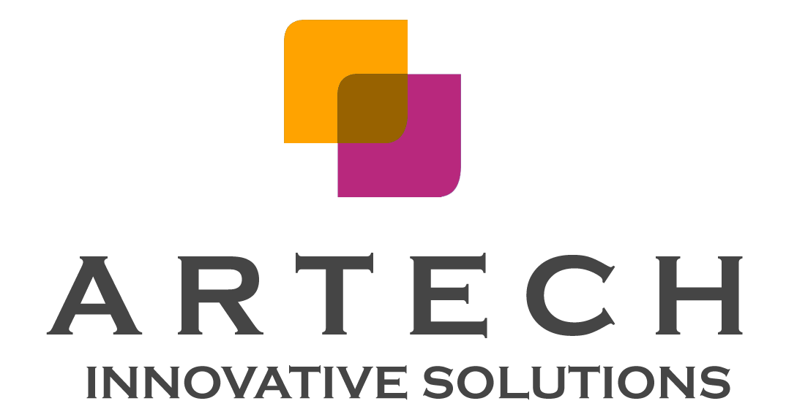
Notes:
blockchain-based art trade platform.

Slide 2
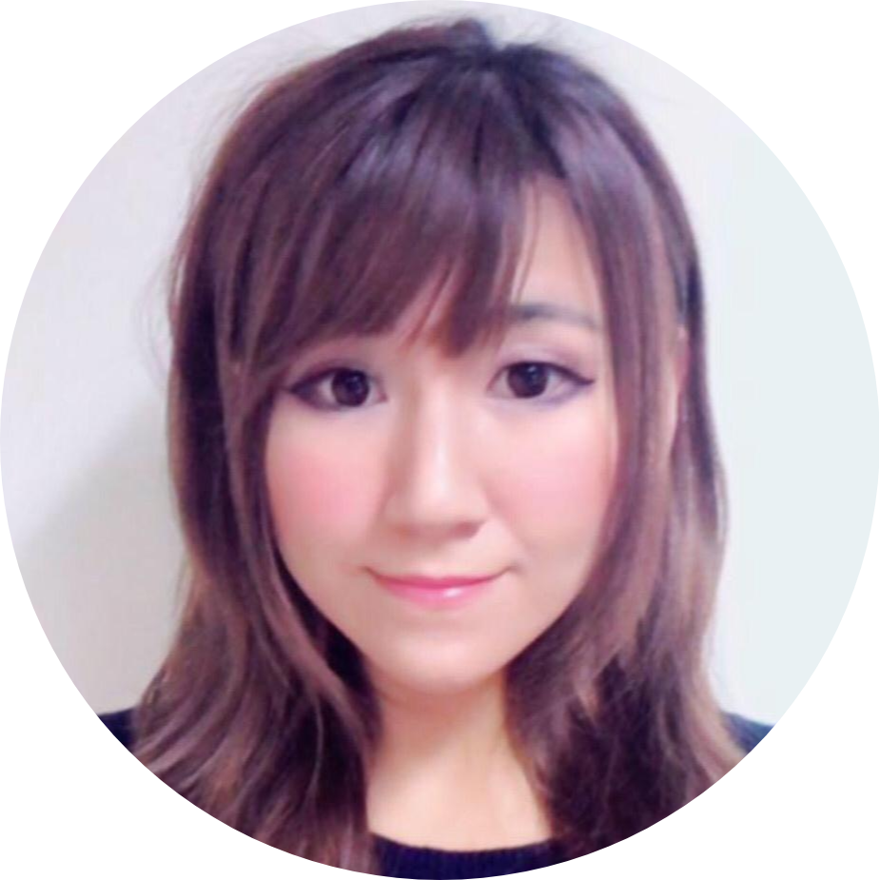
about me
Previous work experience in
human recourses and data analysis fields
Bachelor Degree
University of Toronto
Economics and Environment
Master Degree
The Chinese University of Hong Kong
Information Technology Management
Blockchain Development Cert
George Brown College
Graduating Dec 2020
Notes:
I have worked in both data analytics and human recourses roles for 6 years in Toronto and Hk, now I am completing my study in blockchain development with GBC and ITM master’s degree with the Chinese university of HK. I did my bachelor degree years ago in university of Toronto.

Slide 3

Current Problems
Art sales in the online market amounted to $4.64 billion in 2018 and is forecasted to increase to a total of $9.32 billion by 2024 - Statista
For art market, problems are:
Difficulty to verify authenticity and provenance
“over 50% of the artworks it had examined were either forged or not attributed to the correct artist. Provenance and authenticity are the main parts to determine the artwork’s value. ” - The Fine Arts Expert Institute (FAEI)
“A real good reproduction can fool a lot of experts,” said John Szoke, a Manhattan dealer in Picasso and Edvard Munch prints.
High commission from third party
Overvalued - Loss of money
1. https://www.nytimes.com/2020/01/24/arts/design/fake-art-prints.html
2. https://artbasel.com/news/blockchain-artworld-cryptocurrency-cryptokitties
3. https://www.forbes.com/sites/michaelhaley/2020/01/30/digital-art-framed-and-collected-on-blockchain/#79b0f0f38d90
Notes:
Regarding to art trading, art sales only by online market was over 4 billion USD in 2018 and it is forecasted to be continuously growing.
It is common to see the artworks misplaced, marked with inaccurate information, and become untraceable during trading process.
art buyer are lack of confidence about the authenticity [ˌɔ: 三ˈtɪsəti] of artworks appeared in the market. detecting the forgeries can be very difficult, so some may hire the third party to verify for them FOR EVERY trade which could be very expensive.
If you buying a forgery, it means you loss money.
The whole market is not transparent.

Slide 4
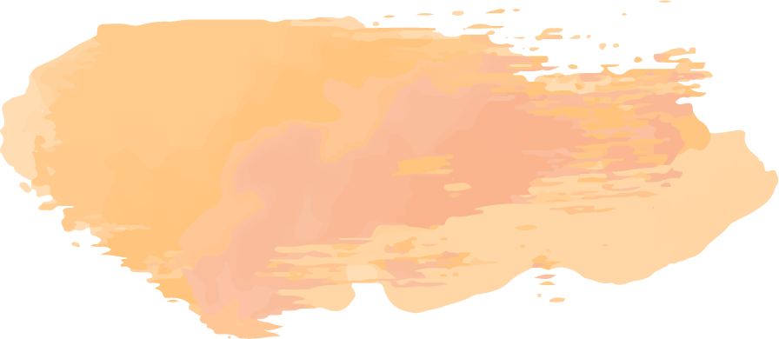
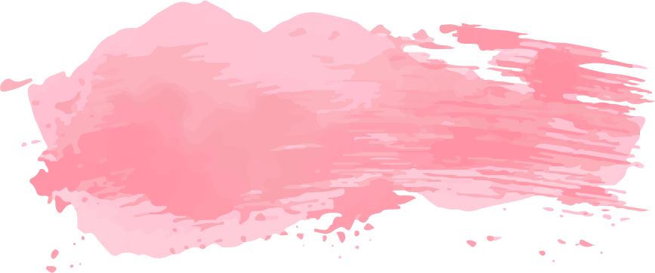
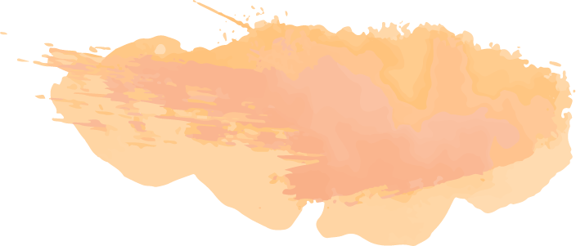
Solution
A digital art market platform for users to buy and sell, using blockchains as a means of recording and sharing secure, authentic proof of origin and provenance for artworks
Based on NFT(non-fungible tokens) - represent the digital ownership of the artwork, and tracing the details of artworks
The goal to utilize the revolutionary technology to bring more transparency to art markets and fight fraud.
Notes:
What Artech offers, it provides a “cryptoArt” market on the blockchain, where art lovers and artists can discover and trade digital art in a safer and more transparent way.
It is based on non fungible tokens. These tokens can be used to represent the digital ownership of the artwork, and track the entire transaction records. It also provides the past owner’s info, title, description, and price of the artwork.
Basicually it allows to tracks the whole lifecycle of the art piece, so bring more transparency to art markets.

Slide 5
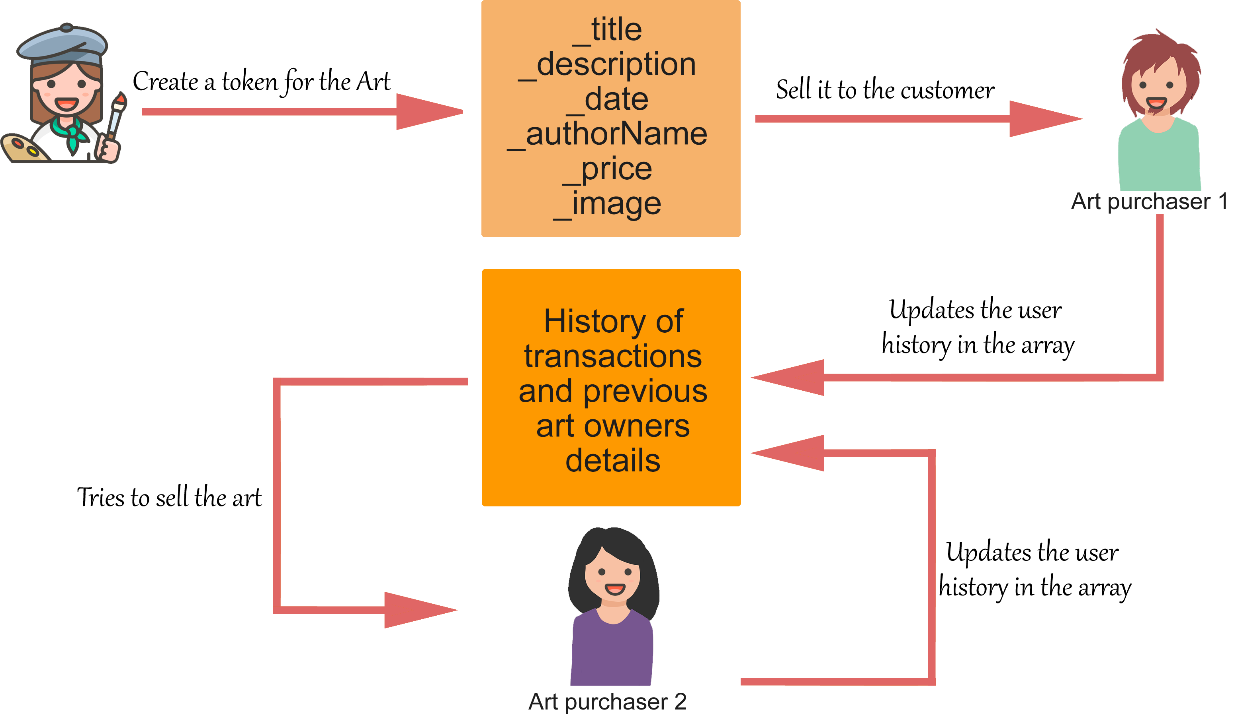
System Process
Notes:
After artist uploads the art, token will be created for the art piece.
Art buyer can view all the available arts for sale.
Once the transaction is proceeded, the system will track down the owner's info.
If the buyer resells it, the history of transaction and other details will be fully available to the next buyer.

Slide 6
Why blockchain?
Non-blockchain
Blockchain
Art detail could be manipulated
– significantly affect its value
Forgery Issue
Unreliable intermediary agent/company
Ensure authenticity
Immutable details
No need third party
Transparent and secure
Notes:
First of all, Each Art piece is assigned with a unique token ID; product information is immutable
Also It removes the middleman which helps user to reduce the cost and save the time
With the non-blockchain solution, the trading will be with a higher risk. authenticity [ˌɔ: 三ˈtɪsəti] cannot be guaranteed, the details of an art piece can be easliy manipulated or even lost; and the third party can be unreliable.

Slide 7
Technology
Notes:
The web app is built with reactJS and web3
the backend is built using NodeJS and Express.
The smart contract is deployed using Truffle and Ganache.
//The generated abi is stored in the backend.
//ReactJS uses the abi from backend to interact with the smart contract.
//Web3 module is used in the react app to call the functionalities of the smart contract.

Slide 8
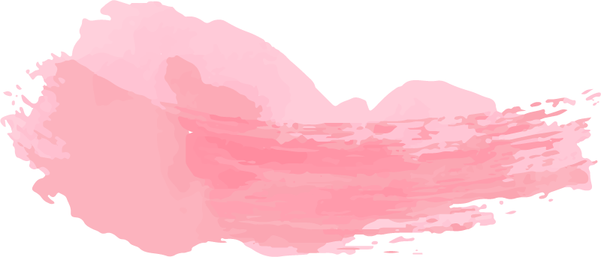
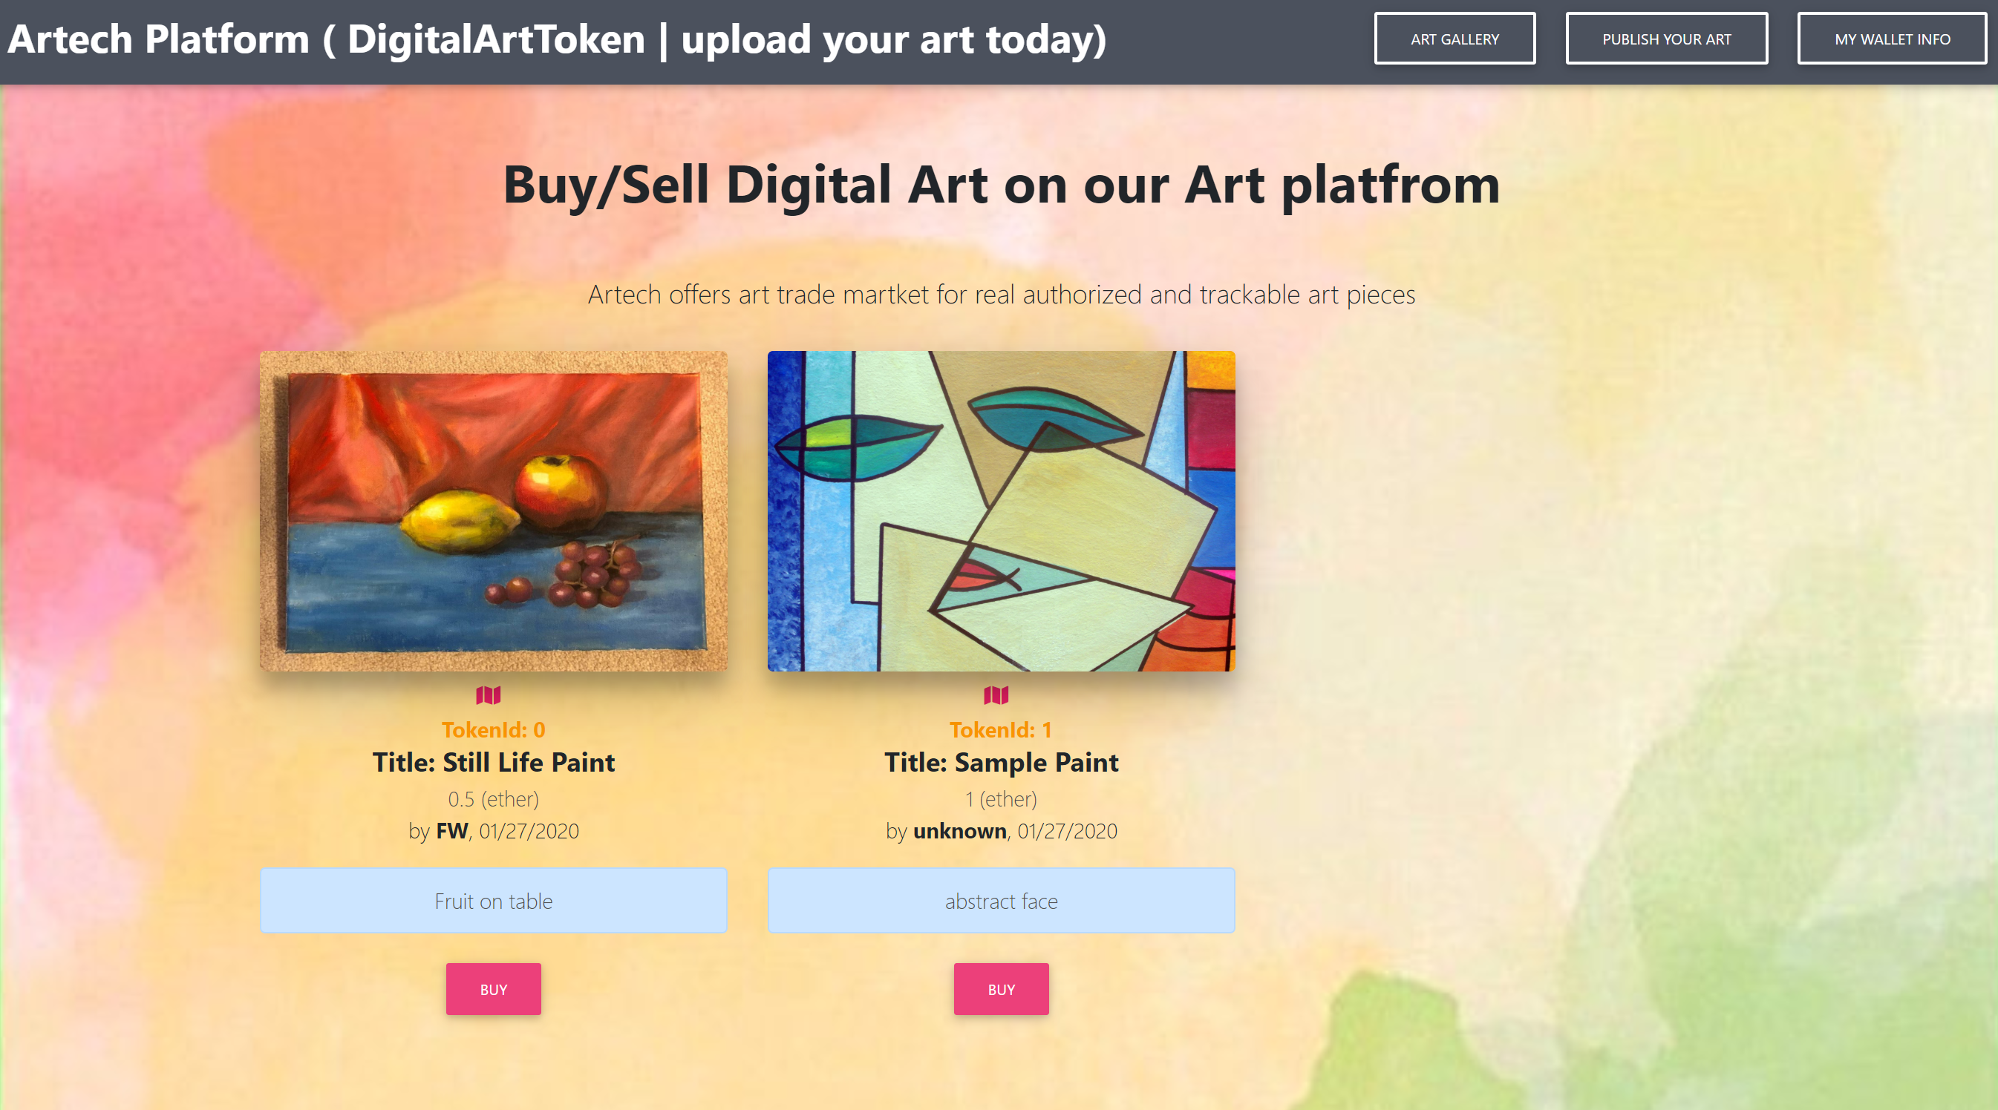
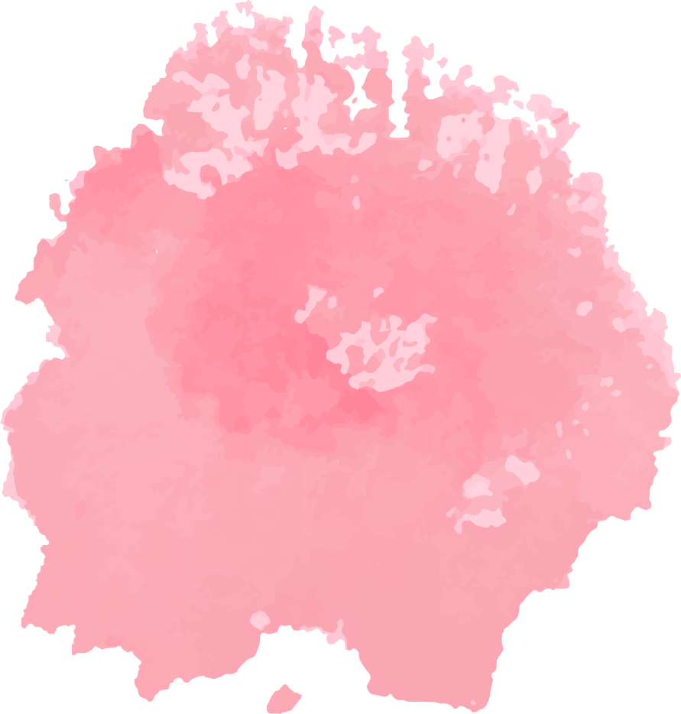
DEMO
Notes:
I collaborated with others to build this app, credit to Muzammil for the smart contract

Slide 9
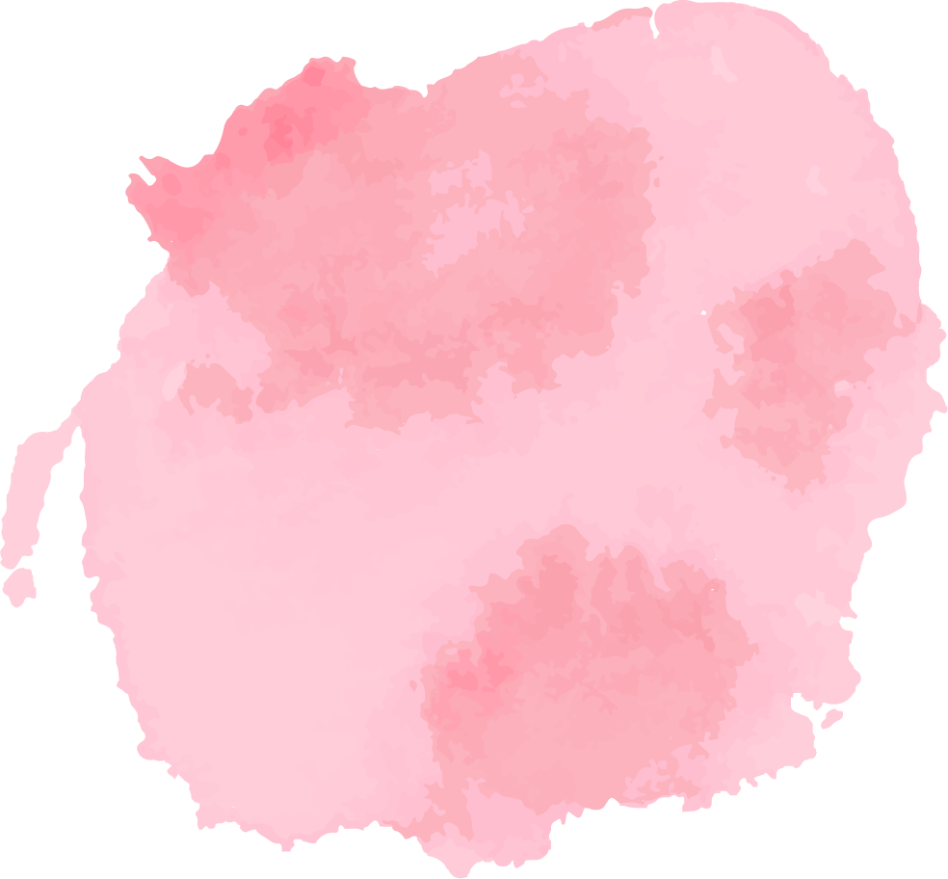
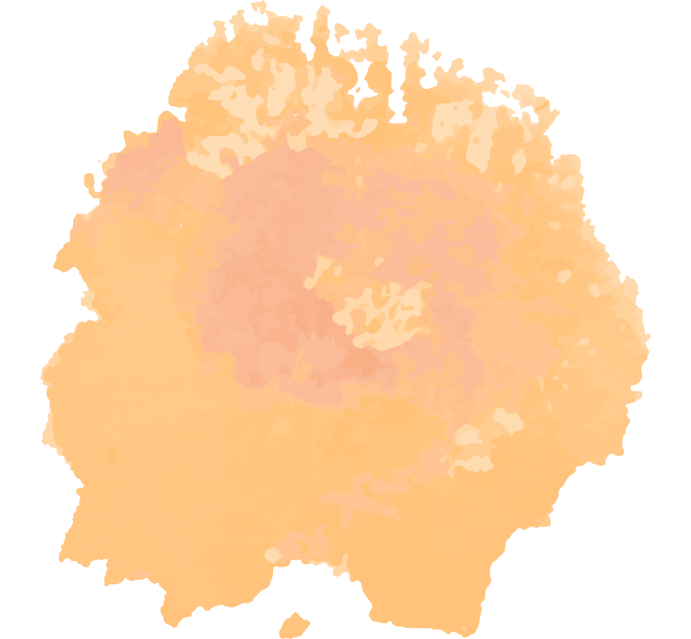
Let’s reshape the art sales industry! Making every artwork in the market trackable and authorized
feiya.wang@georgebrown.ca https://github.com/wfykitty https://www.linkedin.com/in/feiya/

Slide 10

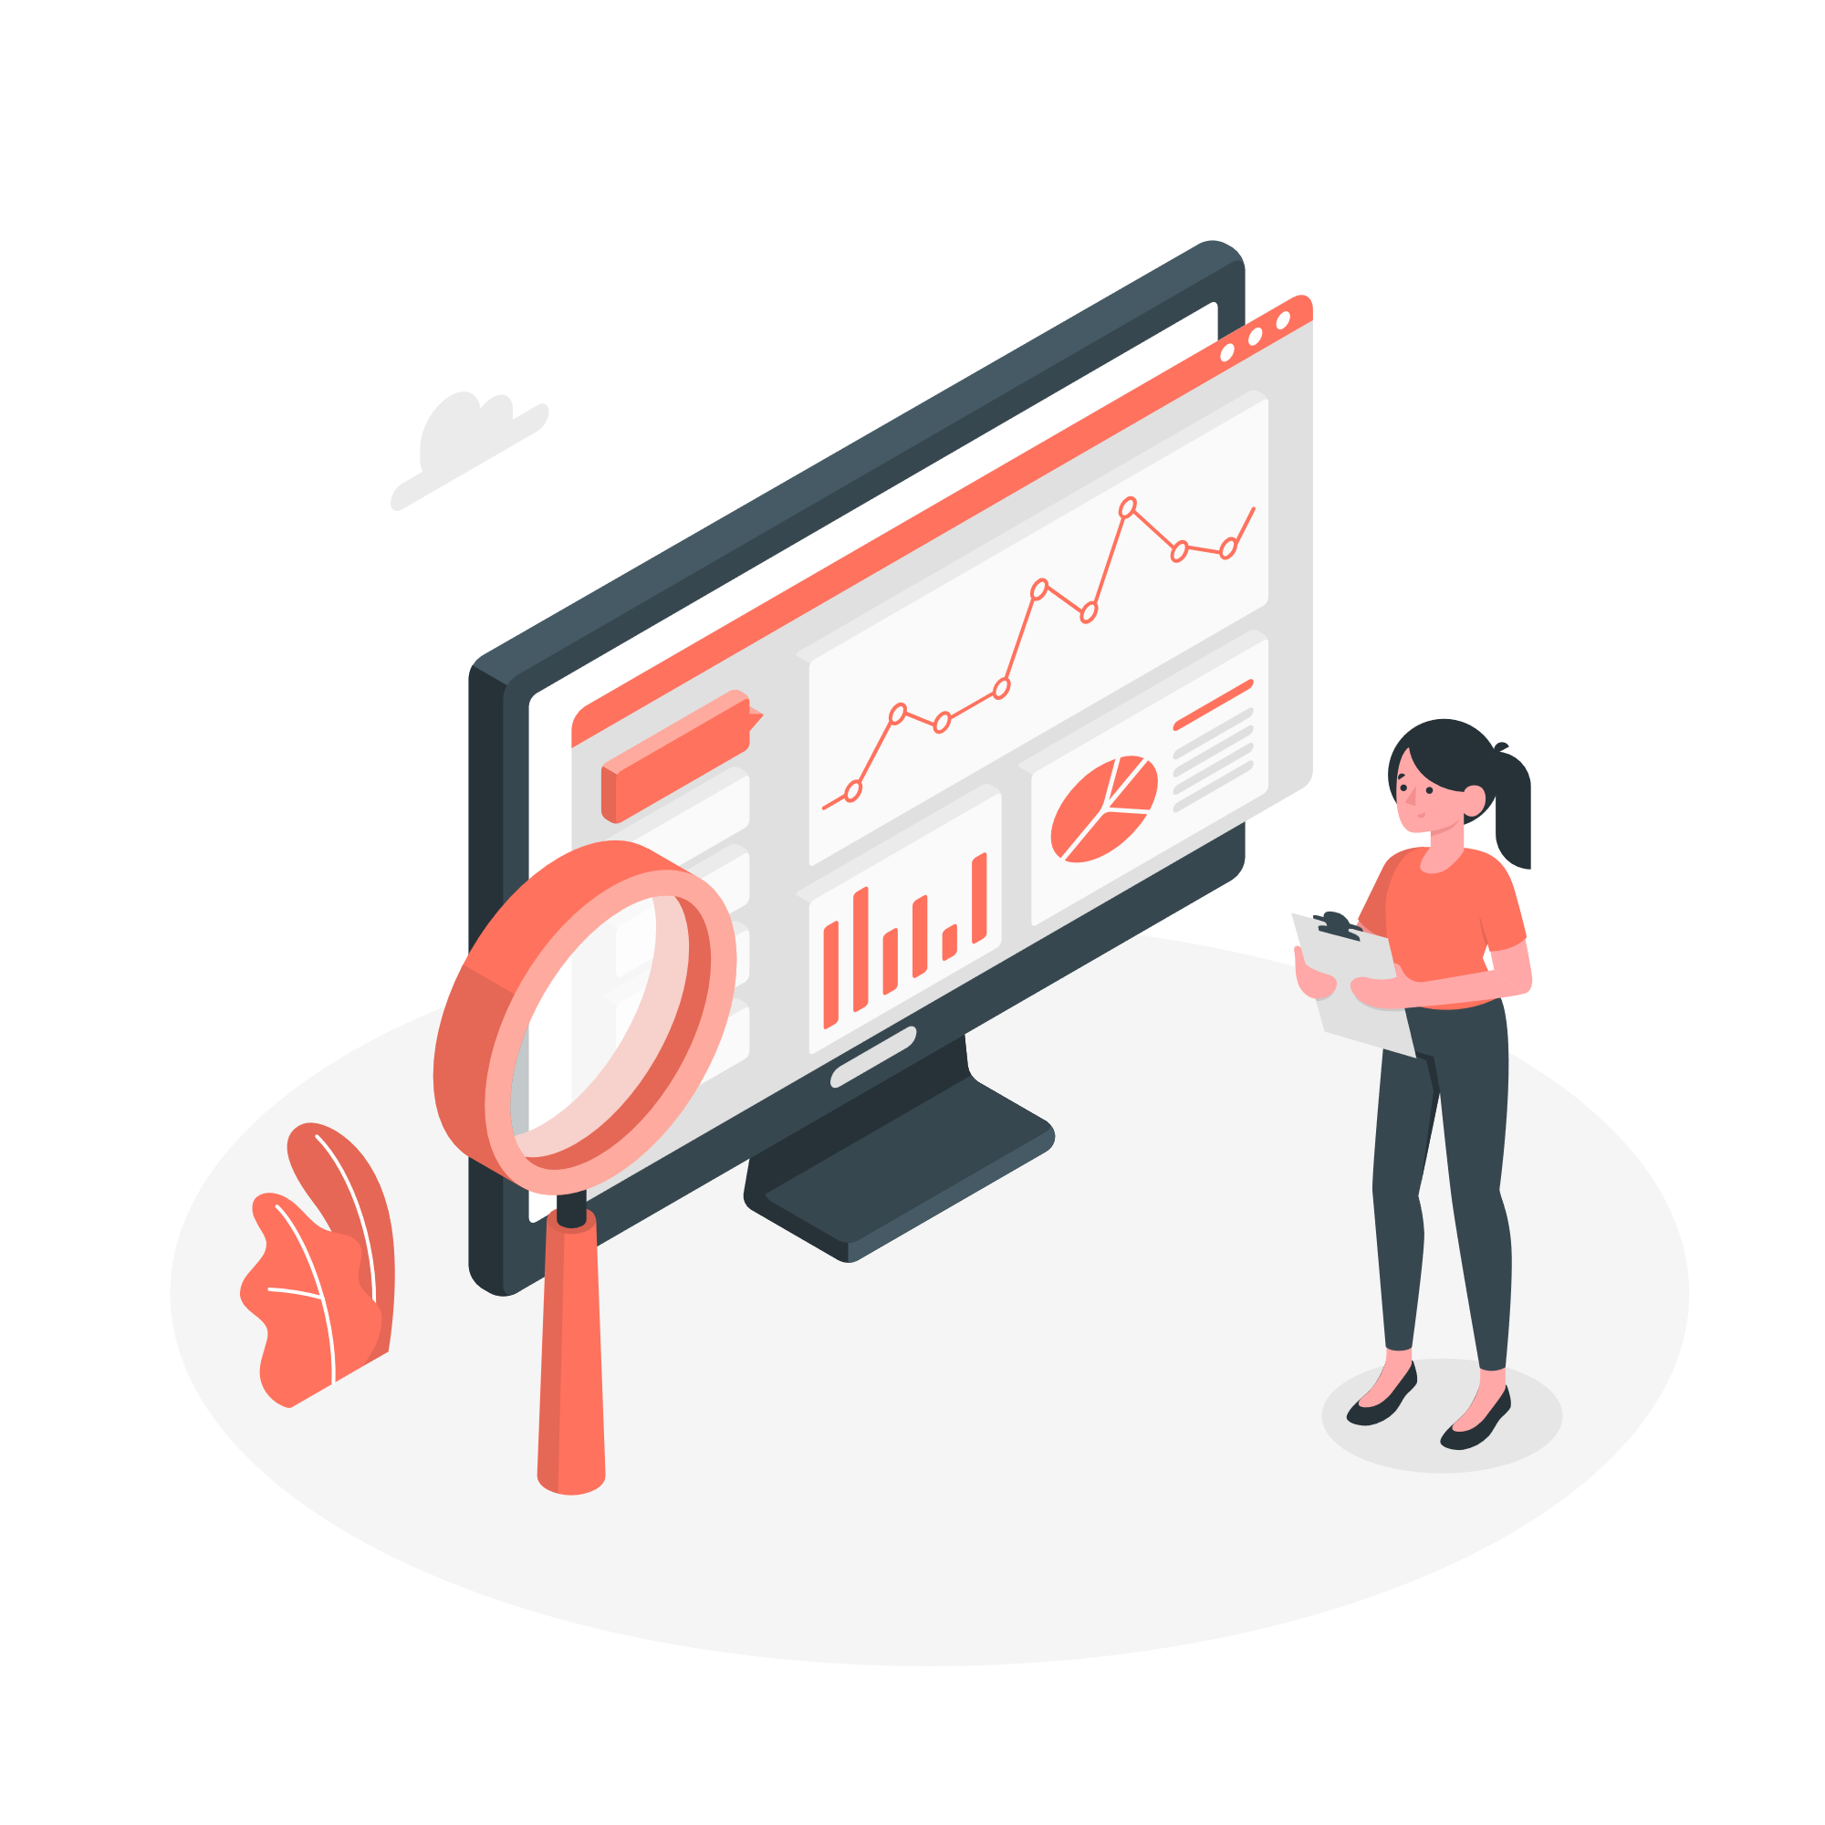
Leverage other technology
Blockchain Technology
Data Analytics
Ensure the art work provenance
Analyzes the sales trend of their art piece, and their customers
Track the transaction/trading records
IoT Device
Intelligent tracker with unique number for each art piece
Notes:
IoT Sticker can be other truth system to further guarantee the authortification of the art piece that are needed to be delievred.
DA can be applied for users to analyzes the sales trend of their art piece, and analyze their customers’ preferred paint style, and location, and etc.

